Slide 1
Photomicrographs of Plant foods
Garlic
Permission to reproduce original photomicrographs used to make this collection may be obtained from
Dr. David O. Norris at
david.norris@colorado.edu

Slide 2
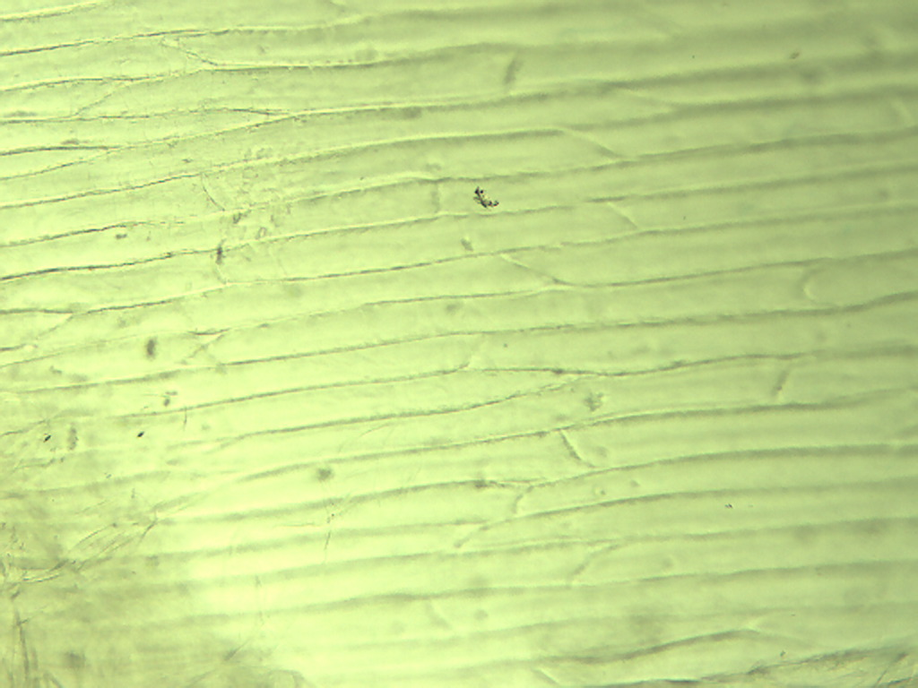
Notes:
197. Allium sativum L. Garlic. Epidermal cells in surface skin of clove, 10X.

Slide 3
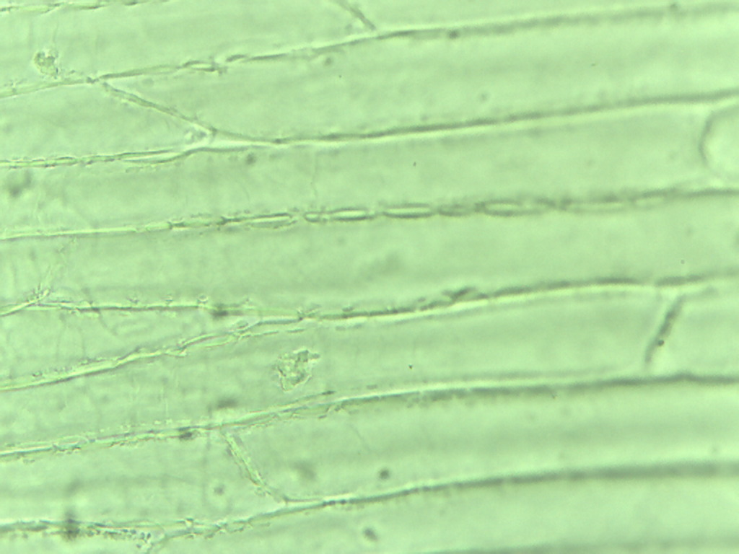
Notes:
198. Garlic. Epidermal cells in surface skin of clove, 25X.

Slide 4
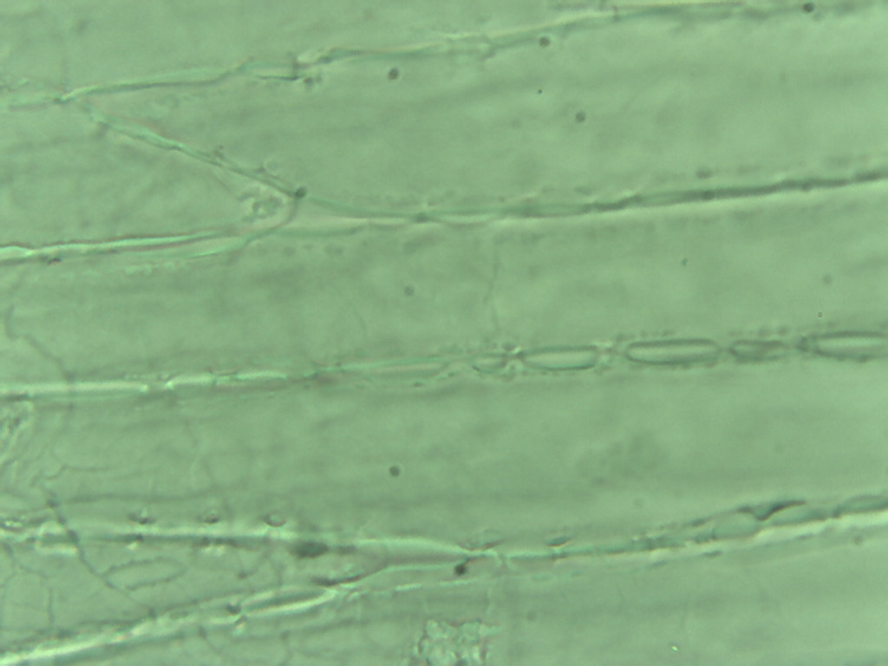
Notes:
199. Garlic. Epidermal cells in surface skin of clove, 40X.

Slide 5
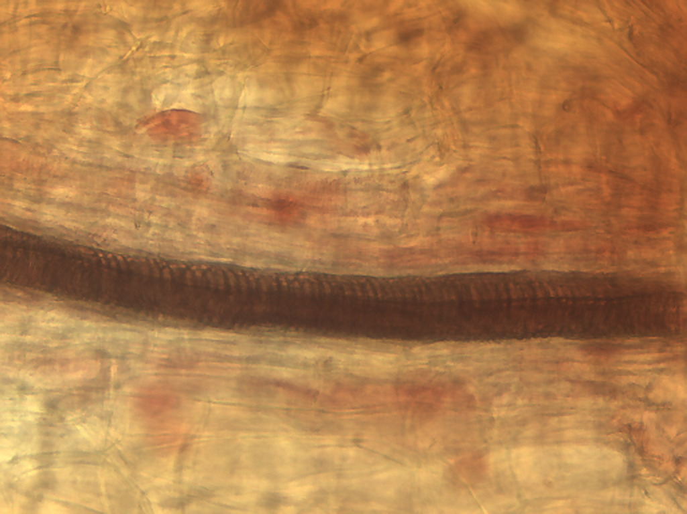
Notes:
200. Garlic. Vessel in surface skin of clove stained with safranin, 25X.

Slide 6
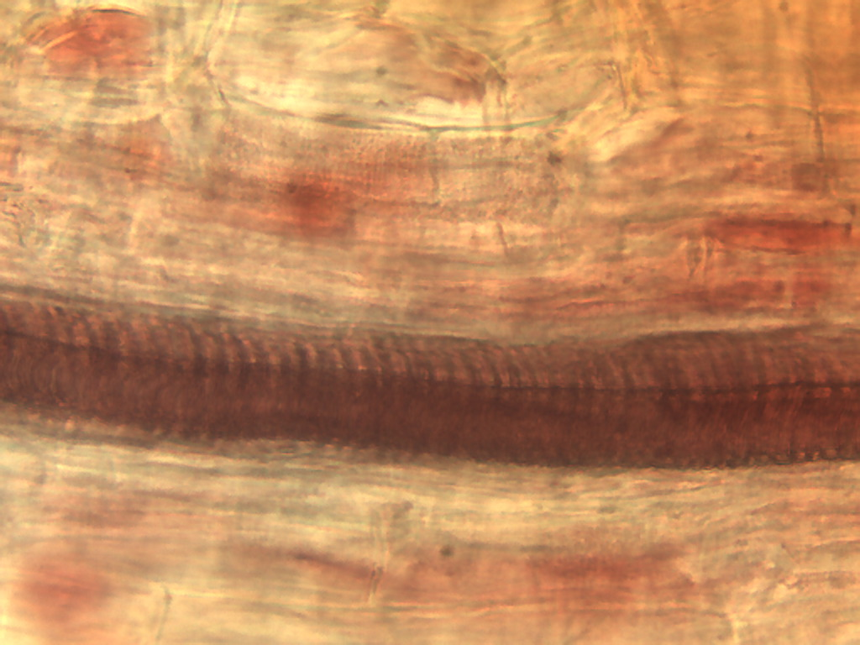
Notes:
201. Garlic. Vessel in skin of clove stained with safranin, 40X

Slide 7
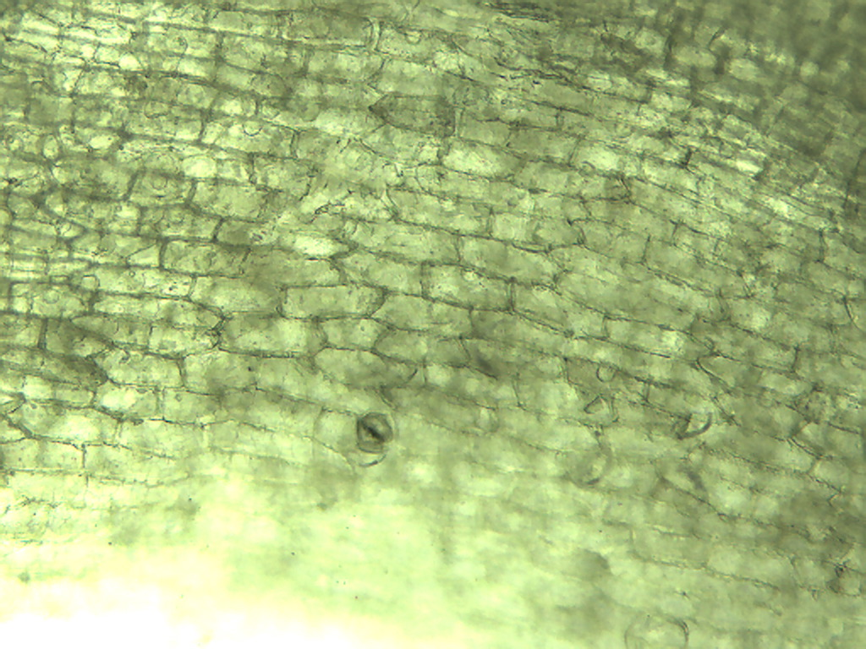
Notes:
202. Garlic. Clove epidermal cells in outer epidermal layer, 10X. Stomate (arrow).

Slide 8
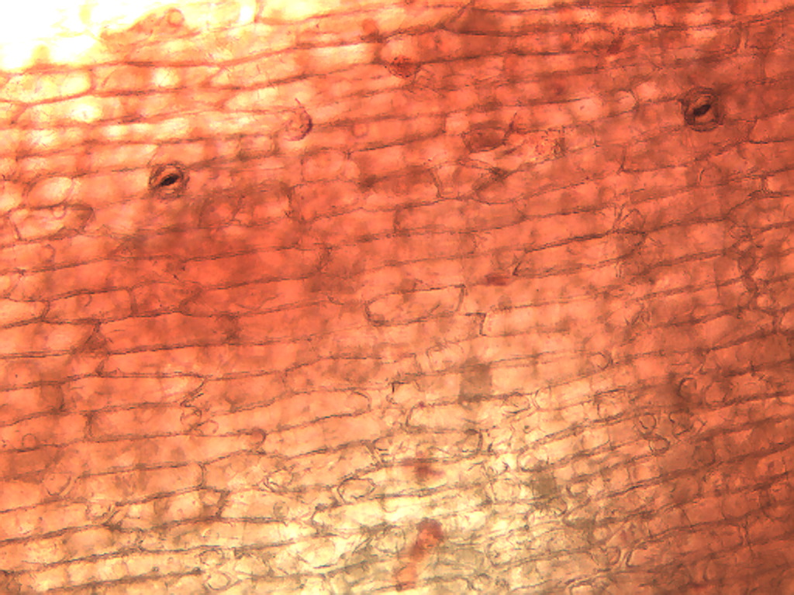
Notes:
203. Garlic. Clove epidermal cells in outer epidermal layer stained with safranin, 10X. Stomates (arrows)

Slide 9
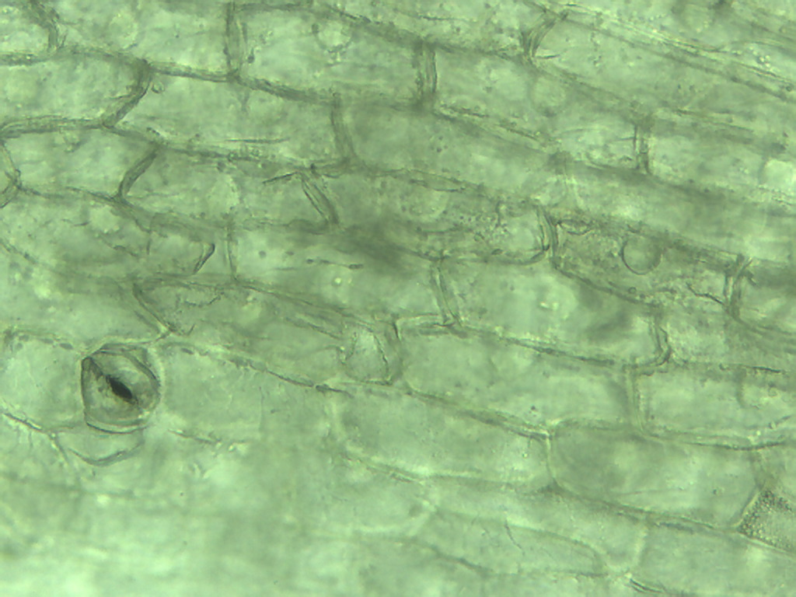
Notes:
204. Garlic. Clove outer epidermis with stomate (arrow), 25X.

Slide 10
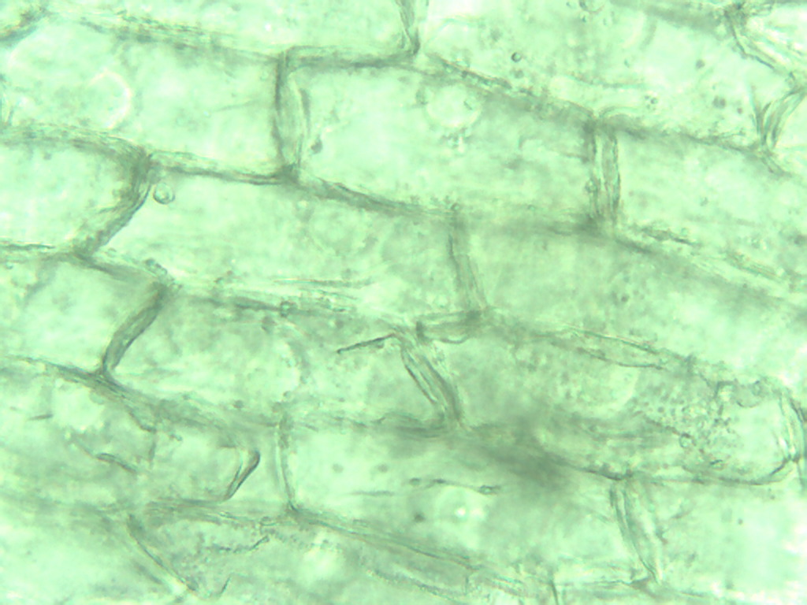
Notes:
205. Garlic. Clove outer epidermal cells, 40X.

Slide 11
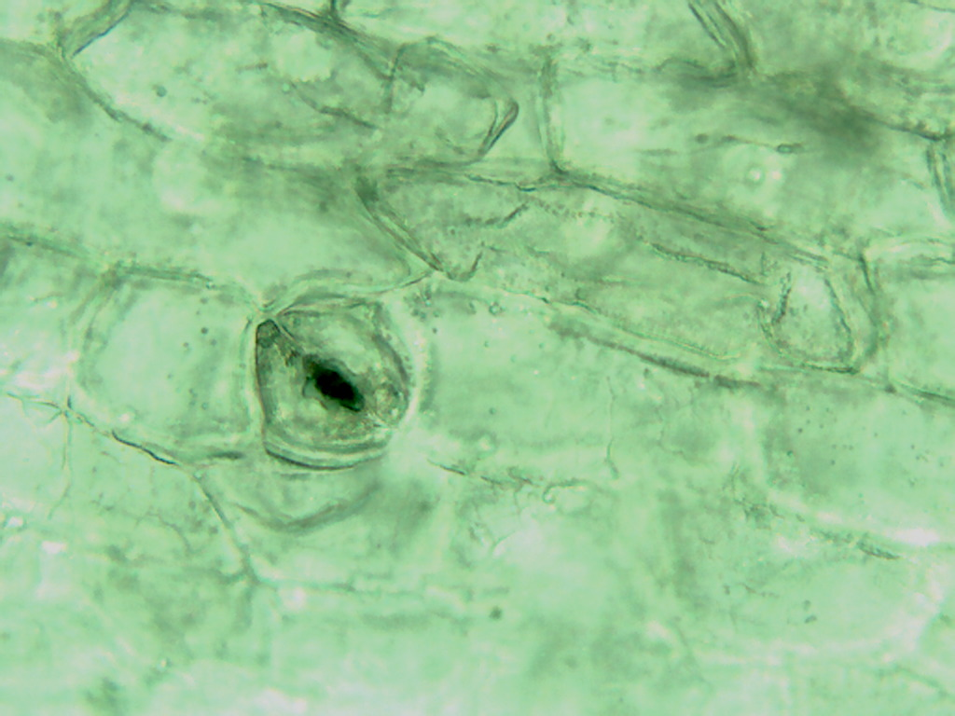
Notes:
206. Garlic. Clove epidermal stomate (arrow) , 40X.

Slide 12
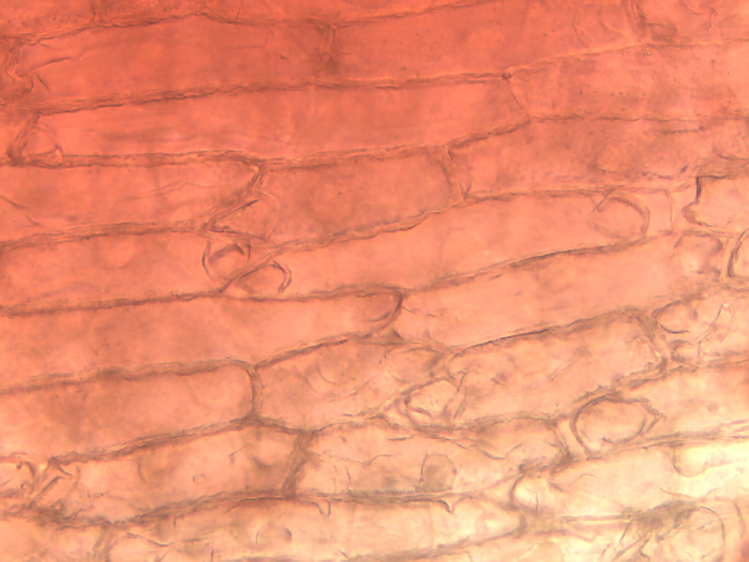
Notes:
207. Garlic. Clove epidermal cells in outer epidermal layer stained with safranin, 25X.

Slide 13
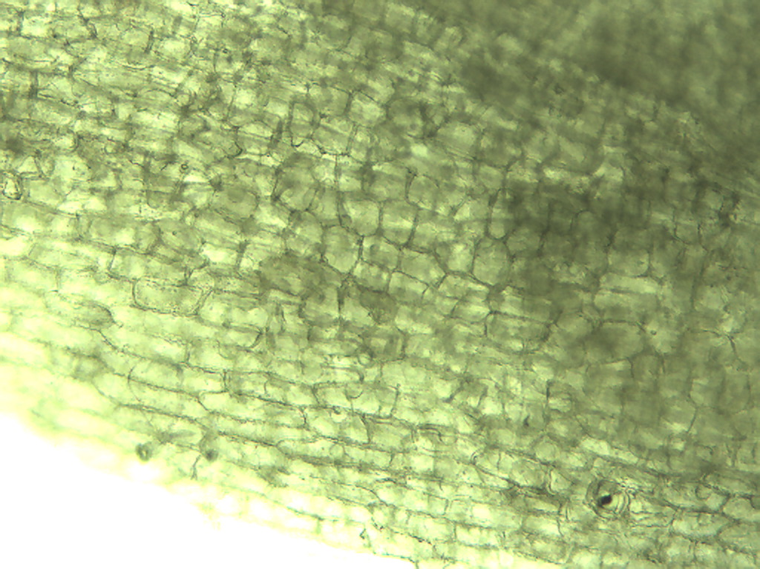
Notes:
208. Garlic. Clove inner epidermal cell layer, 10X. Note cells are more cuboidal than in outer layer.

Slide 14
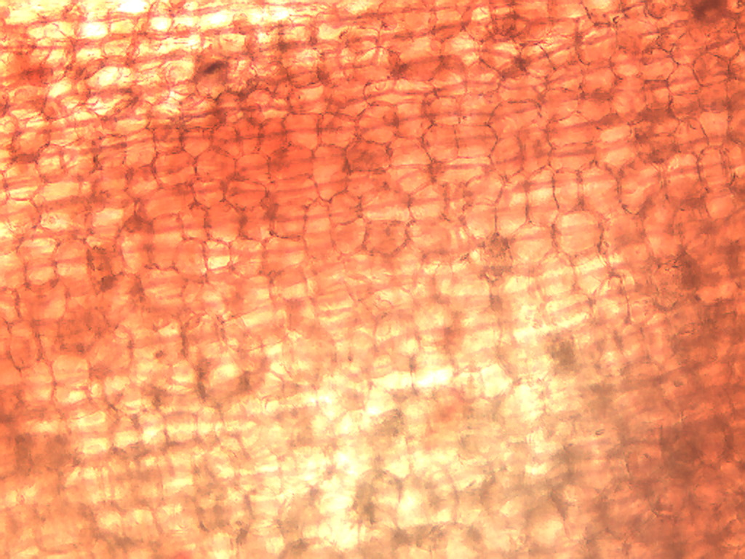
Notes:
209. Garlic. Clove inner epidermal layer cells, stained with safranin,10X.

Slide 15
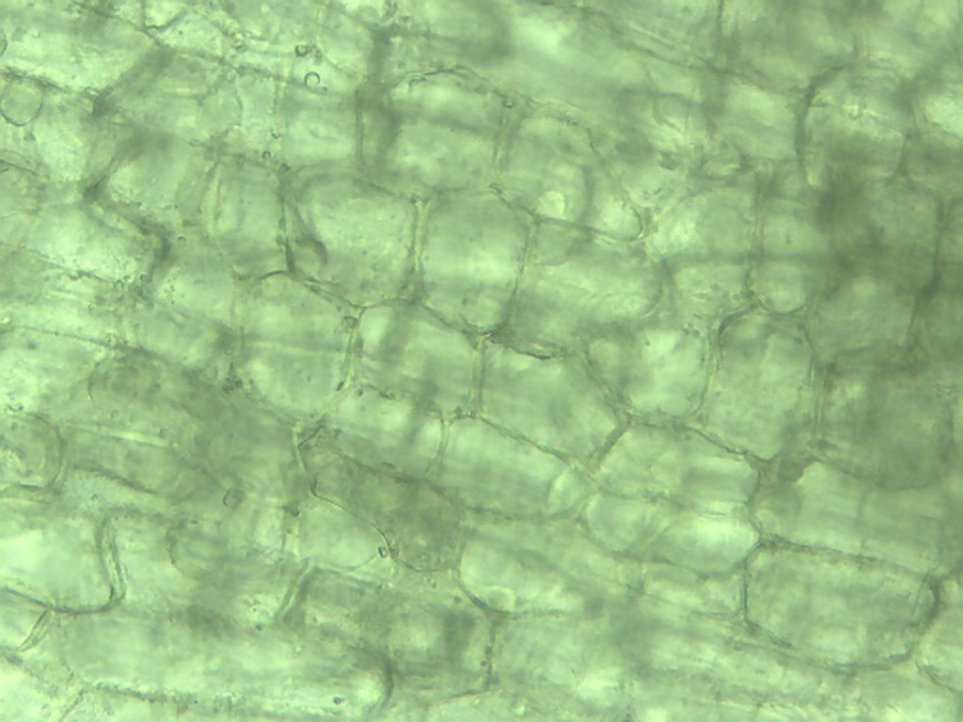
Notes:
210. Garlic. Clove inner epidermal layer cells, 25X.

Slide 16
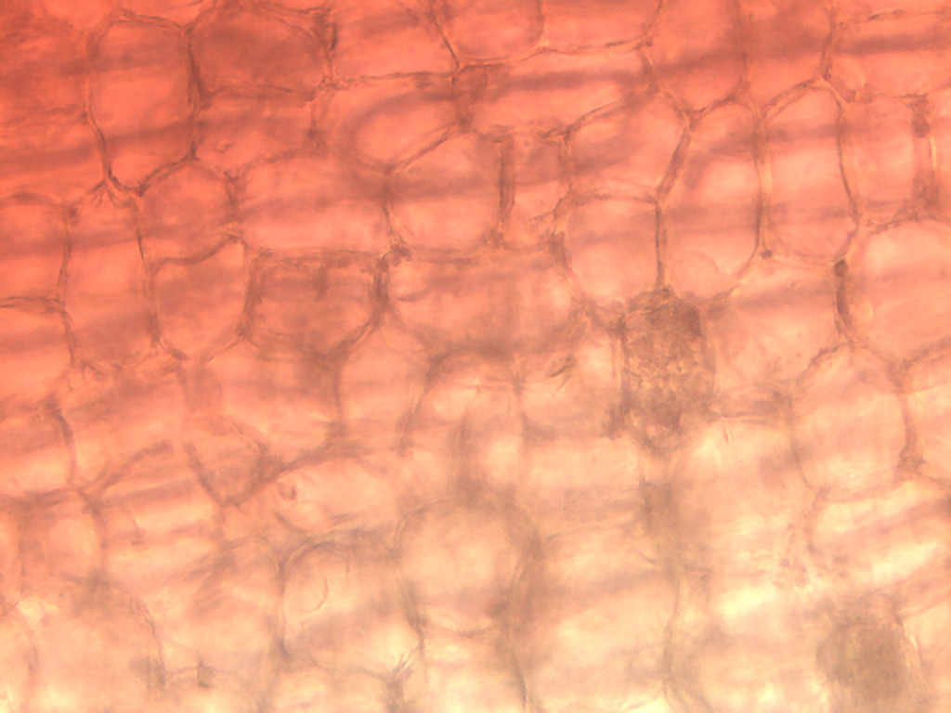
Notes:
211. Garlic. Clove inner epidermal layer cells, safranin stain, 25X.

Slide 17
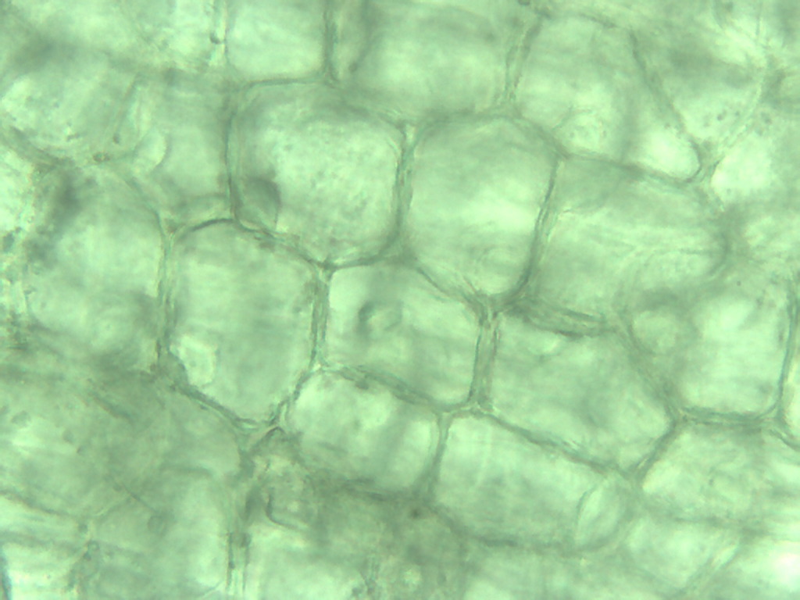
Notes:
212. Garlic. Clove inner epidermal layer cells, 40X.

Slide 18
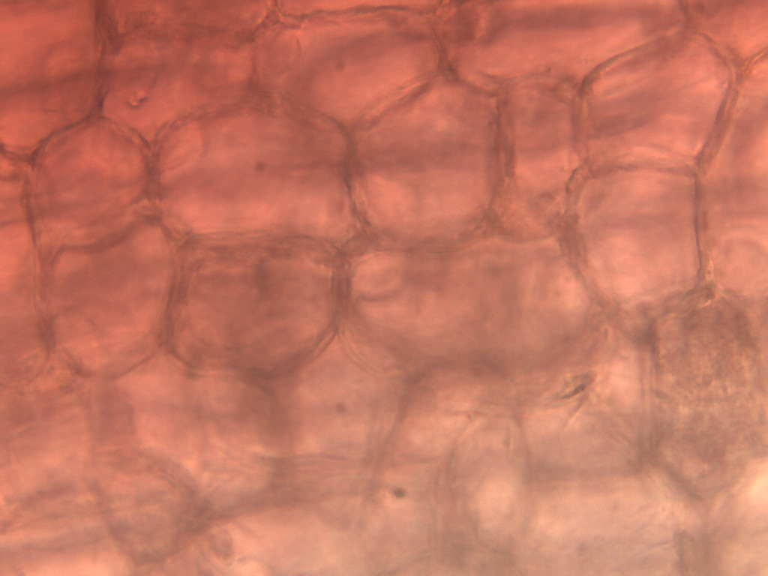
Notes:
213. Garlic. Clove inner epidermal layer cells, safranin, 40X.

Slide 19
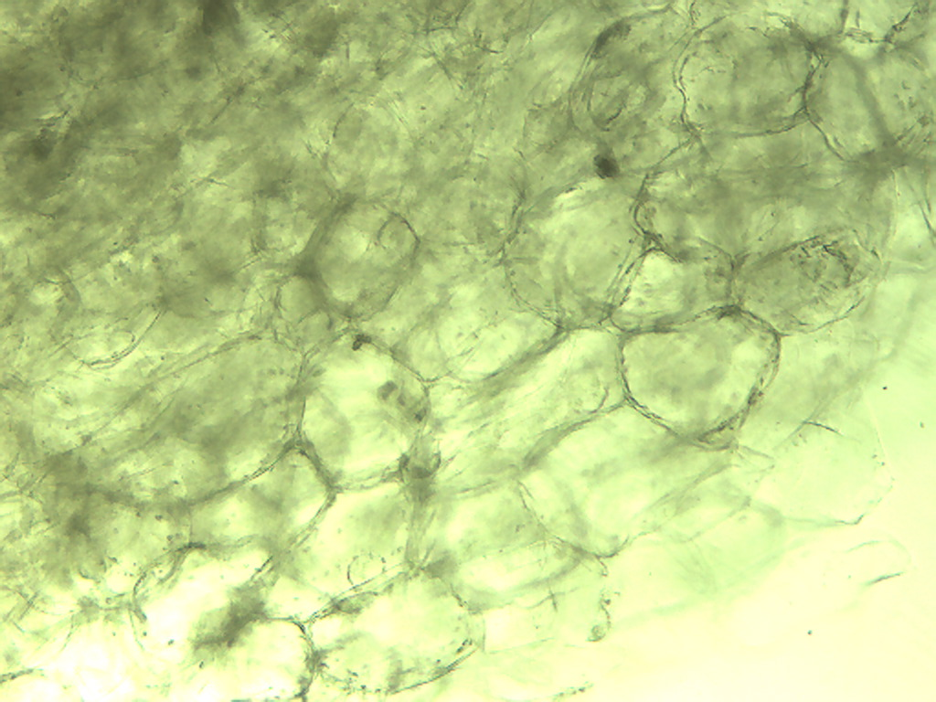
Notes:
214. Garlic. Clove, parenchymal cells, 10X.

Slide 20
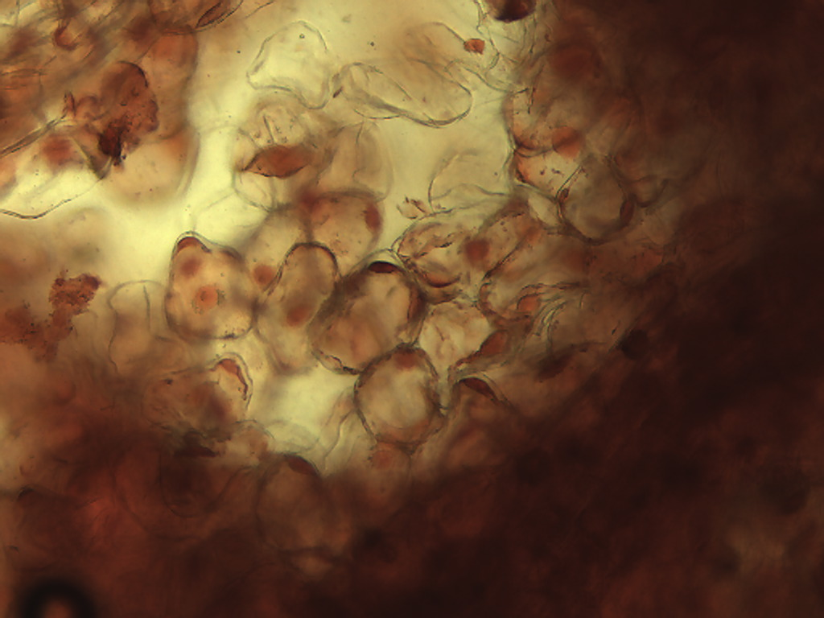
Notes:
215. Garlic. Clove, parenchymal calls, safranin stain, 10X.

Slide 21
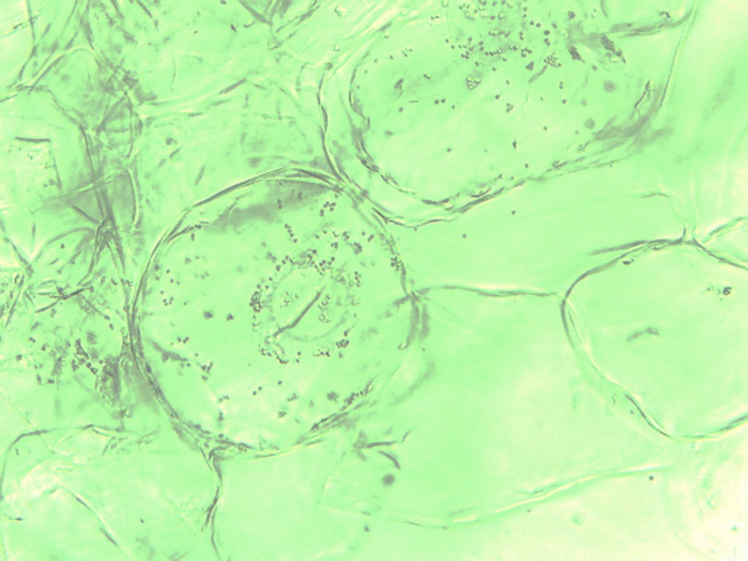
Notes:
216. Garlic. Clove, parenchymal cells, 25X

Slide 22
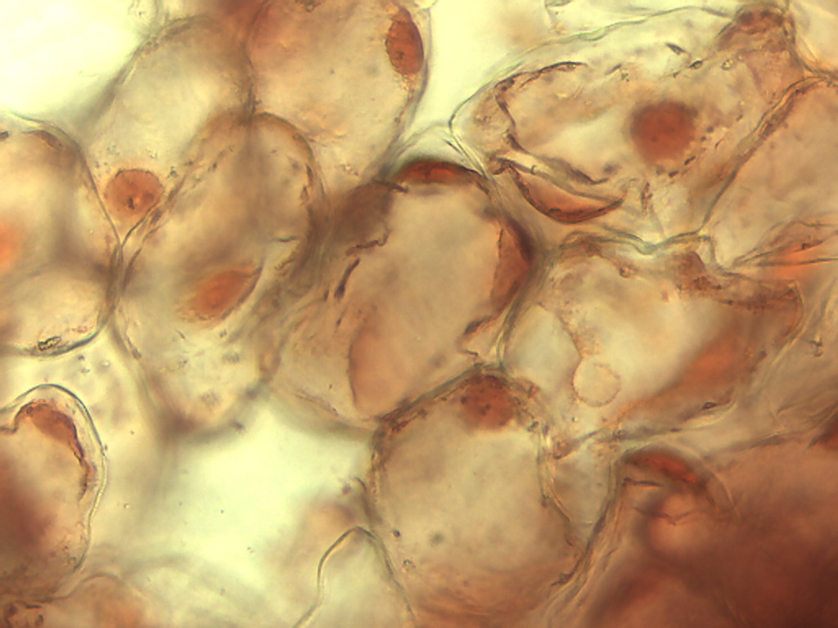
Notes:
217. Garlic. Clove, parenchymal cells, safranin stain, 25X.

Slide 23
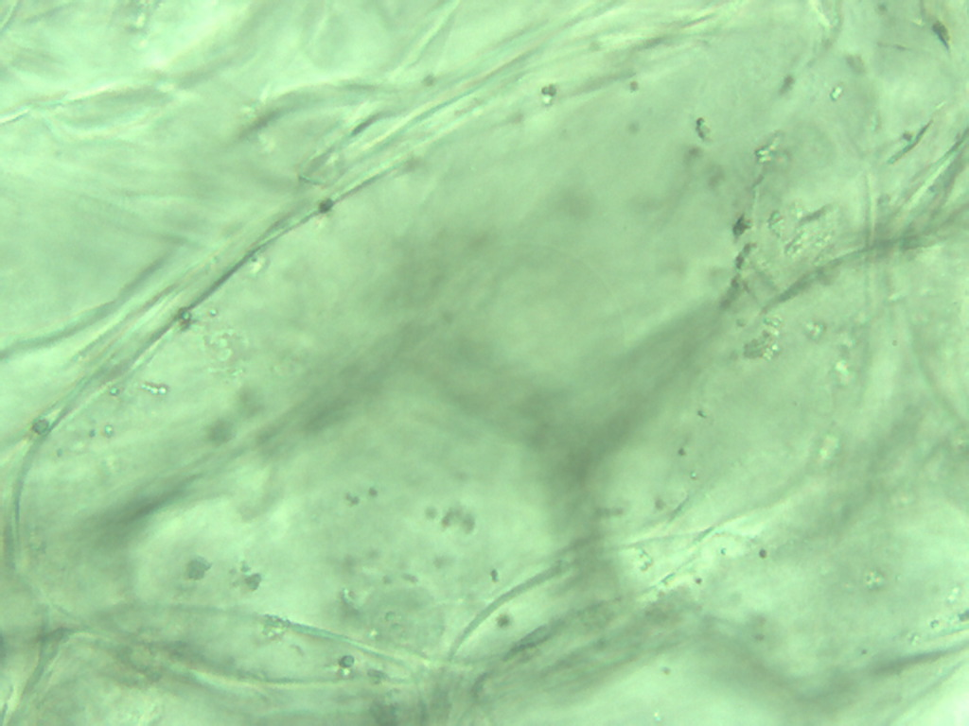
Notes:
218. Garlic. Clove, parenchymal cells, 40X

Slide 24
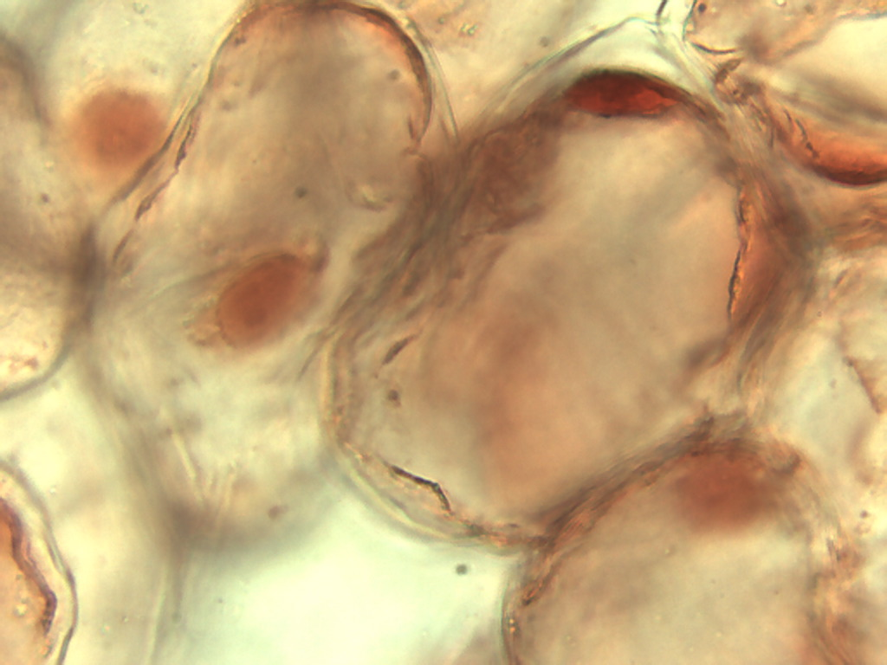
Notes:
219. Garlic. Clove, parenchymal cells, safranin stain, 40X

Slide 25
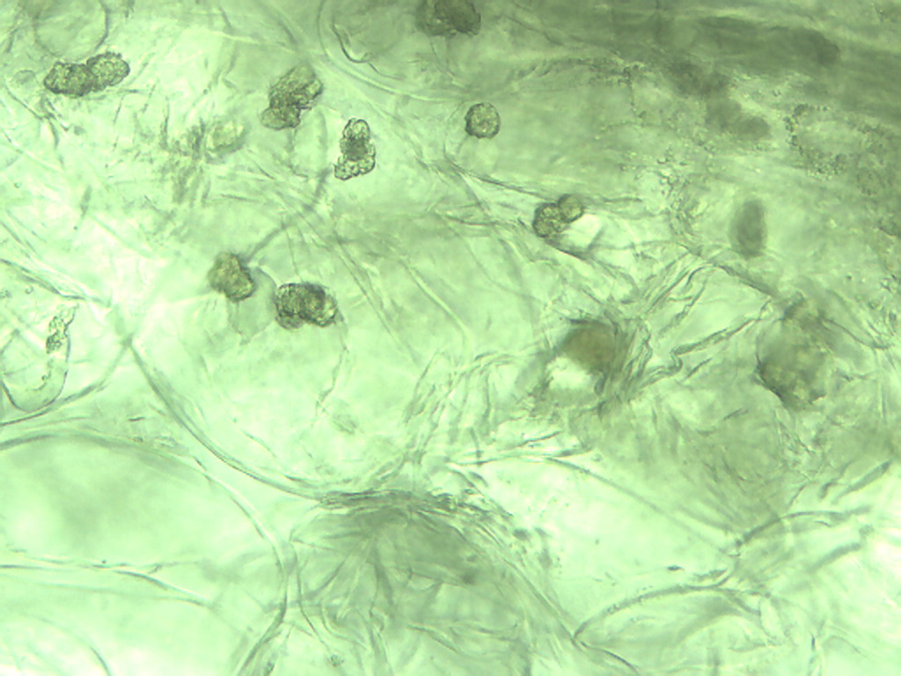
Notes:
220. Garlic. Clove druse crystals, 25X.

Slide 26
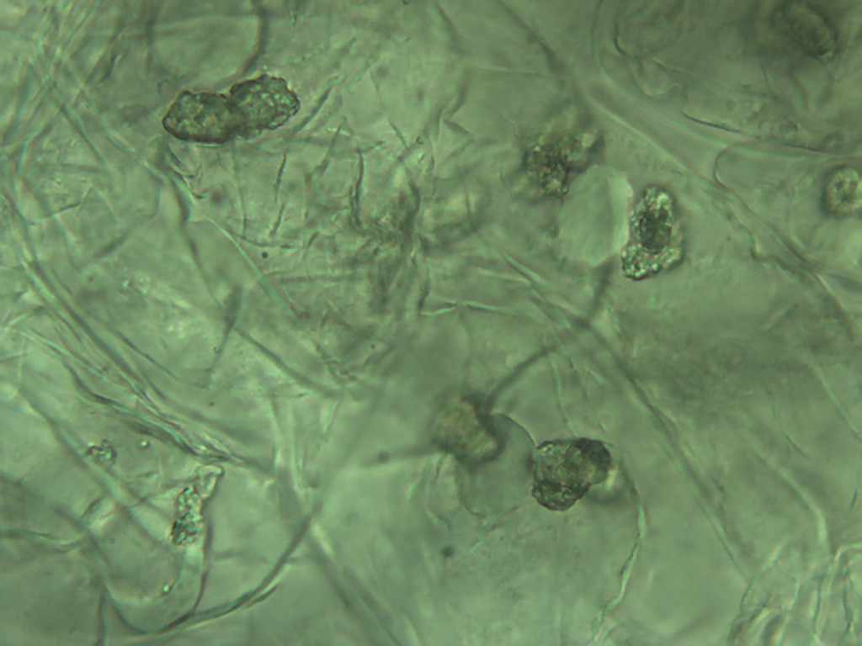
Notes:
221. Garlic. Clove druse crystals, 40X.

Slide 27
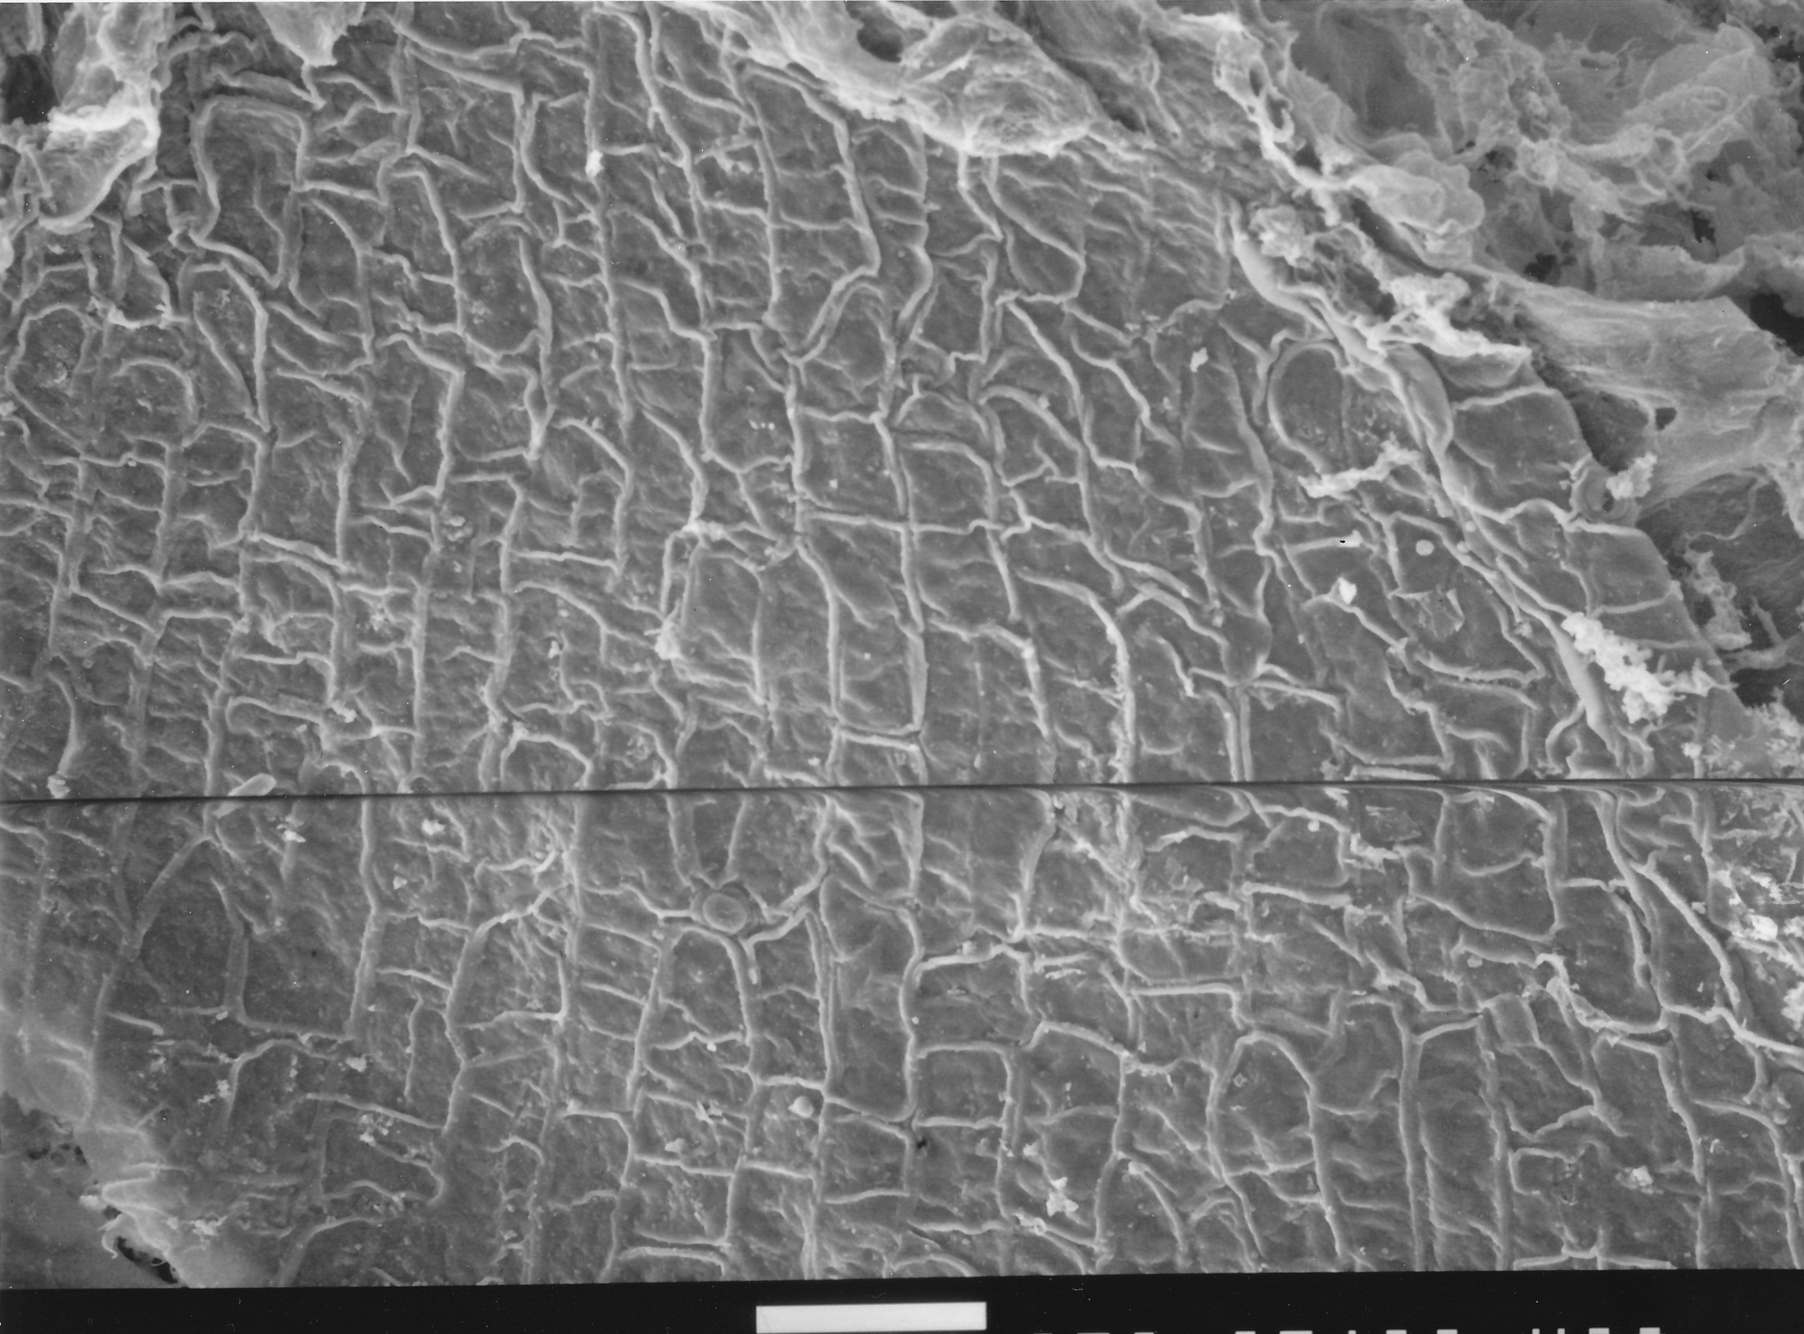
100 µm
Notes:
222. Garlic. SEM. Courtesy of Dr. Meredith A. Lane.

